Slide 1

Introduction to Classification and Applications of DL in CV

Slide 2
Contents
Introduction to Classification
Classification Workflow
Data Collection
Data Preparation
Building Classifier
Assessing Classifier
Applications of DL in Computer Vision

Slide 3
Intro to Classification
Classification is the process of identifying distinct groups or classes of data based on their features or characteristics.
Examples:
Given batting stats, classifying whether a batsman is good or average or bad
Given subject and body of email, classifying it as a normal or spam
Given details of a financial transaction, classifying it to be genuine or fraudulent
Given the images of a tumour, classifying it to be benign or malignant
Given the parameters of a process in an industry, classifying whether there is fault in the process or not
Classifier
Input-Output Relation
Output class
Input

Slide 4
Learning for Classification
Question: What is the need for learning?
Answer: Input-Output relation is not known in most of the cases
Learn input-output relation from input-output data
Having relevant input features and relevant data is important to learning a good classifier
Classifier
Input-Output Relation
Output class
Input
Feedback: Input-Output data

Slide 5
Classification Workflow
Data Collection
Collect relevant data along with class label
Data Preparation
Clean the data and fill any missing values
Pre-process the data as necessary
Build Classifier
Train classifier by learning relation between input features and output classes
Test Classifier
Assess the classifier performance

Slide 6
Data Collection
Data required for to build a classifier depends on what exactly is the classification problem
Classification Problem | Data to be Collected/Sampled
 | Input | Output
Classifying whether a batsman is good, average, bad | Batting stats such as average, strike rate, number of 50s and 100s, etc. of many batsmen | Whether batsman is good, average or bad
Classification of email as spam or not | Subject and body of the email of many emails | Whether email is spam or not
Classification of financial transactions | Transaction amount, time of transaction, date of transaction, place of transaction, etc. | Whether transaction is fraud or genuine
Classification of tumours | Size and Colour of tumour, symptoms, other medical conditions, etc. | Whether tumour is malignant or benign

Slide 7
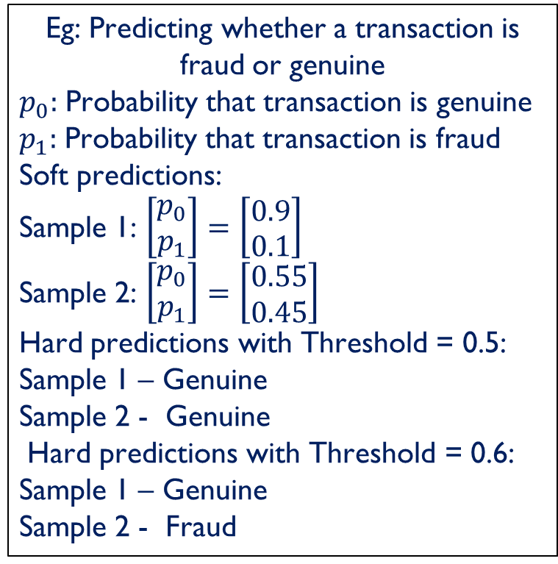
Soft vs Hard Predictions in Classification
Soft Prediction: Classifier predicts the probability of a data point belonging to a each of the target classes
Hard Prediction: Classifier predicts the class that the data point might belong to
Soft prediction gives more information on the confidence of the classifier in the prediction made
Soft prediction can be turned into a hard prediction by setting a probability threshold
Eg: Predicting whether a transaction is fraud or genuine
$p_{0}:$ Probability that transaction is genuine
$p_{1}:$ Probability that transaction is fraud
Soft predictions:
Sample 1: $\left[\begin{matrix}p_{0} \\ p_{1}\end{matrix}\right]=\left[\begin{matrix}0.9 \\ 0.1\end{matrix}\right]$
Sample 2: $\left[\begin{matrix}p_{0} \\ p_{1}\end{matrix}\right]=\left[\begin{matrix}0.55 \\ 0.45\end{matrix}\right]$
Hard predictions with Threshold = 0.5: Sample 1 – Genuine
Sample 2 - Genuine
Hard predictions with Threshold = 0.6: Sample 1 – Genuine
Sample 2 - Fraud

Slide 8
Assess Classifier Performance
Ideally, the classifier should predict the class labels of all the samples without any errors
Since errors are inevitable, one needs to track for how many samples, the class labels are predicted correctly and for how many the predicted labels are erroneous
Error tracking is done using Confusion Matrix

Slide 9
Confusion Matrix
A table or a matrix with different combinations of predicted and actual values for different classes for a given probability threshold
For a binary classification task, the confusion matrix is:
Actual Values
Class 0
Class 1
Class 0
# Samples Correctly
Classified as Class 0
# Samples Wrongly
Classified as Class 0
Predicted Values
# Samples Wrongly
Classified as Class 1
# Samples Correctly
Classified as Class 1
Class 1

Slide 10
Building a Confusion Matrix: Example
Sample ID | Predicted Class | Actual Class
1 | 0 | 0
2 | 1 | 0
3 | 1 | 1
4 | 0 | 0
5 | 1 | 1
6 | 1 | 1
7 | 1 | 0
8 | 0 | 1
9 | 0 | 0
10 | 1 | 1
Actual Values
Class 0
Class 1
Class 0
3
1
Predicted Values
Class 1
2
4

Slide 11
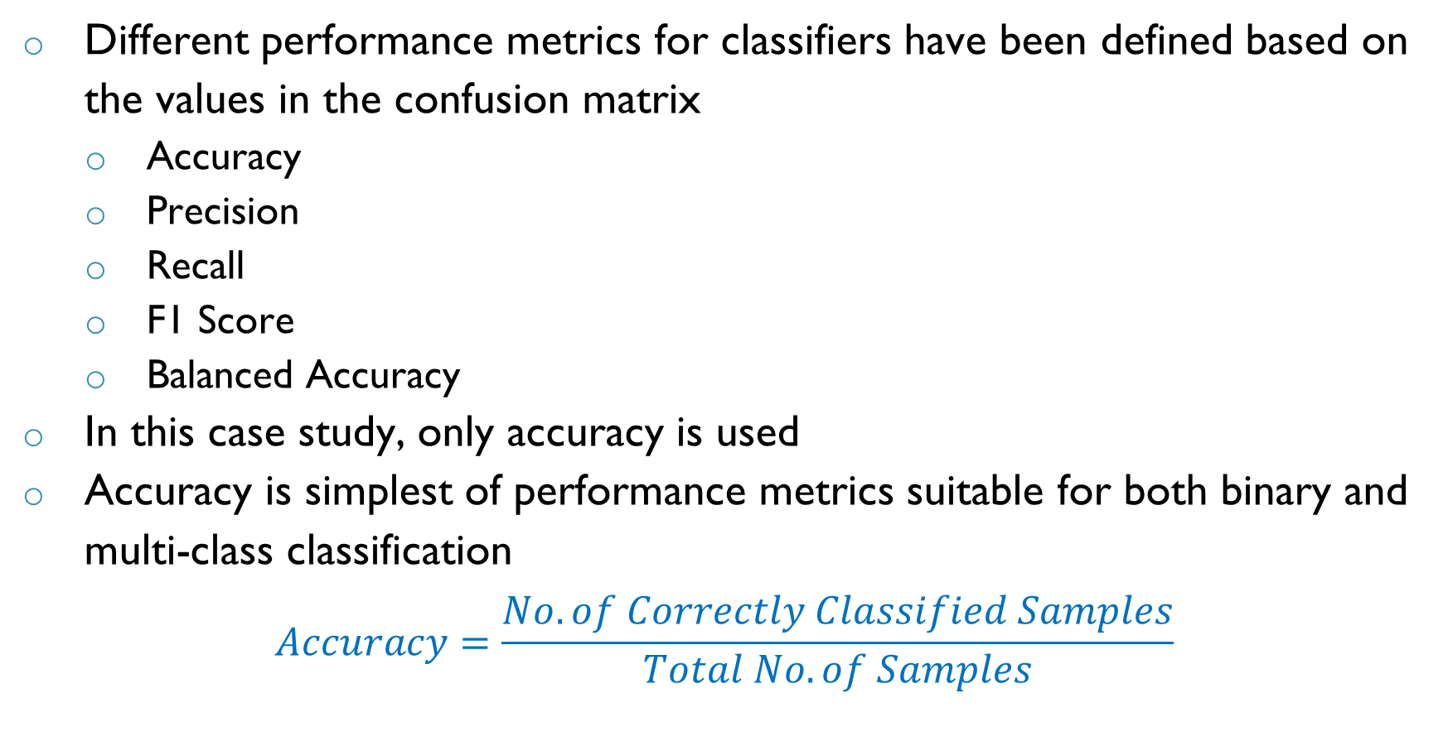
Performance Metrics
Different performance metrics for classifiers have been defined based on the values in the confusion matrix
Accuracy
Precision
Recall
F1 Score
Balanced Accuracy
In this case study, only accuracy is used
Accuracy is simplest of performance metrics suitable for both binary and multi-class classification
$$Accuracy=\frac{No. of Correctly Classified Samples}{Total No. of Samples}$$

Slide 12
Applications of DL in Computer Vision

Slide 13
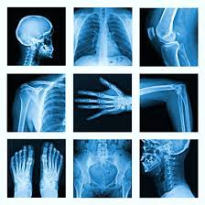
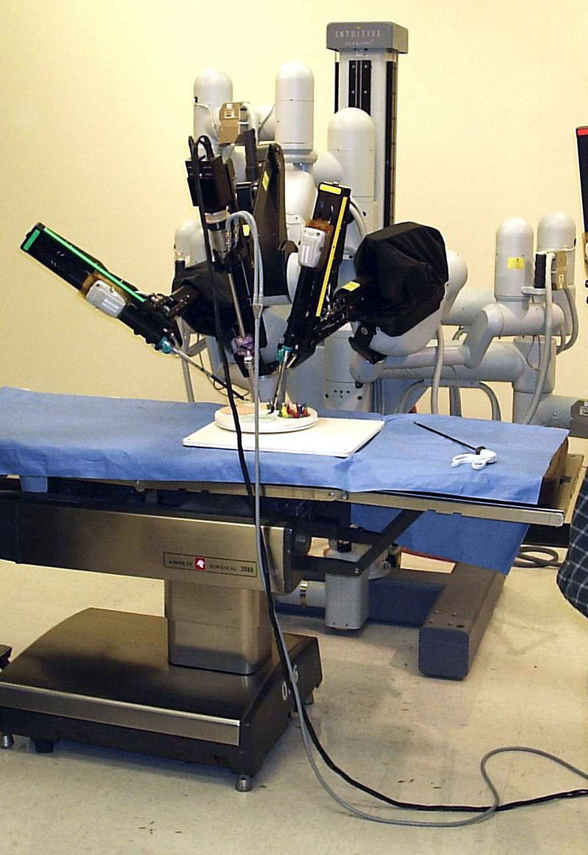
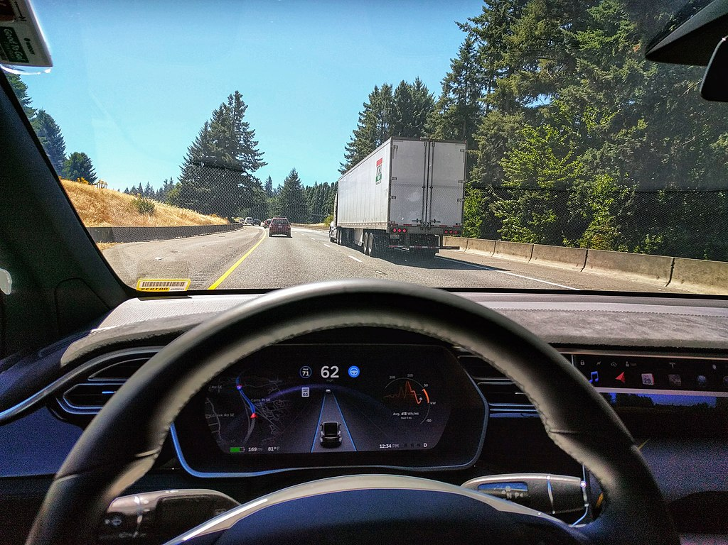
Applications of DL in Computer Vision
Medical Imaging
Patient diagnosis
Medical surgeries
Object detection
Traffic management and control
Self driving cars
Images Source: Wikipedia/ Google Images

Slide 14
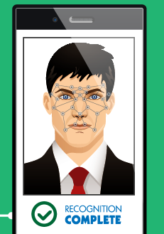
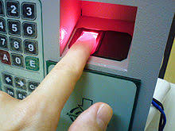

Applications of DL in Computer Vision
Face & Fingerprint Recognition
Social media platforms
Security applications
Remote sensing applications
Navigational purpose – Google maps
Agriculture
Images Source: Wikipedia/ Google Images

Slide 15
Summary
Classification involves learning input-output relations which can be used to classify samples with unknown classes
Classification workflow involves data collection, processing, training classifier and assessing classifier
Predictions of a classifier can be directly classes or probability that a sample belongs to a particular class
Different metrics exist to assess performance of classifier with accuracy being most popular metric
Applications of Deep Learning in CV are widely encompassing various fields and are ever growing

Slide 16

THANK YOU

